Slide 1
Temperature change correlation with air pollution levels
Data Visualization with Maps and Charts: the role of GIS
MADSAD Official Statistical System Course
Andre costa
GonÇALO MAGALHÃES
KRISTINA Vcelková

Slide 2
Temperature change correlation with air pollution levels
Data Visualization with Maps and Charts: the role of GIS
Proposed Data sets:
File | Source |  | attibutes | observations | Time | Space
Land_and_Ocean_EqualArea.nc | Berkeley Earth foundation | https://berkeleyearth.org/data/ | Year | 33 374 592 (15,984 × 174 years × 12 months) | 1850-2024 | Global (15984 georeferenced areas)
 |  |  | Month
 |  |  | T anomaly
who_ambient_air_quality_database_version_2024_(v6.1).xls | World Health Foundation | https://www.who.int/publications/m/item/who-ambient-air-quality-database-(update-jan-2024) | Country | 40099 | 2010-2022 | 7179 cities all over globe
 |  |  | City
 |  |  | Year
 |  |  | Pm10
 |  |  | Pm25
 |  |  | NO2

Slide 3
Temperature change correlation with air pollution levels Visualization with Maps and Charts: the role of GIS
GSBPM Alignment
Berkeley Earth
Phase 5 – Process: Interpolation, quality control, bias correction
Phase 6 – Analyze: Trend and anomaly detection
Phase 7 – Disseminate: Open APIs and datasets for public use
Phases 2–4 – Design & Collect: Data from national agencies in 6,000+ cities
Phase 5 – Process: Global harmonization and validation
Phase 7 – Disseminate: Public release via WHO portals and publications
WHO Dataset

Slide 4
Temperature change correlation with air pollution levels Visualization with Maps and Charts: the role of GIS
Confidentiality & Statistical Use
Berkeley Earth
No individual-level data → low disclosure risk
High spatial resolution supports regional climate modeling & policy
Aggregated by city — not directly identifiable
May pose indirect disclosure risk when combined with other microdata
Calls for aggregation or anonymization in sensitive use cases
WHO Dataset

Slide 5
Temperature change correlation with air pollution levels Visualization with Maps and Charts: the role of GIS
Quality in Official Statistics
Berkeley Earth
- Detailed documentation and reproducibility
- Relevance
- Accuracy
- Coherence
- Comparability
- Timeliness

Slide 6
Temperature change correlation with air pollution levels Visualization with Maps and Charts: the role of GIS
Quality in Official Statistics
WHO Dataset
Transparent methodology and sources
Fulfills quality criteria:
Availability
Update frequency
Clarity and interpretability

Slide 7
Temperature change correlation with air pollution levels
Data Visualization with Maps and Charts: the role of GIS
Methodology steps
Delete redundant years
Spatial Matching Procedure
Nearest-neighbour spatial matching through latitude and longitude
Annual Aggregation
Correlation analysis
Scatter plots
Maps
Static
Interactive
Regional Comparisons

Slide 8
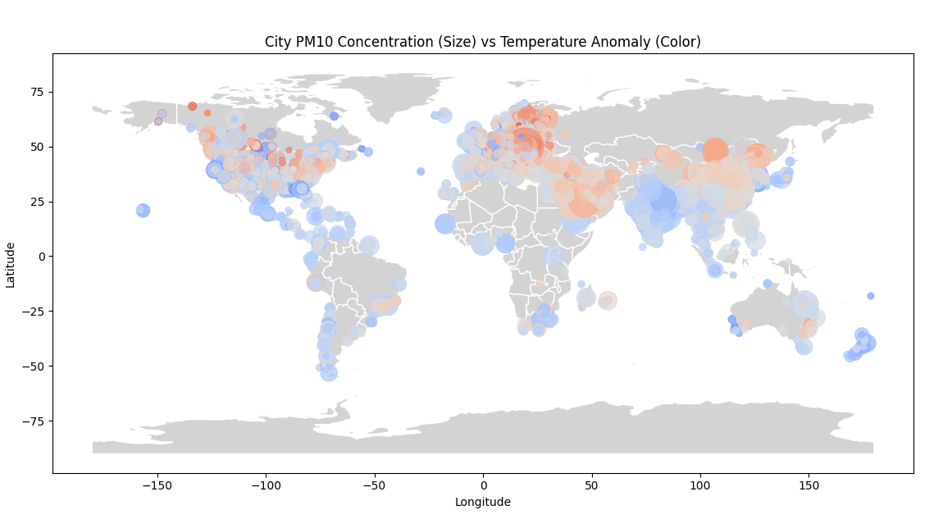
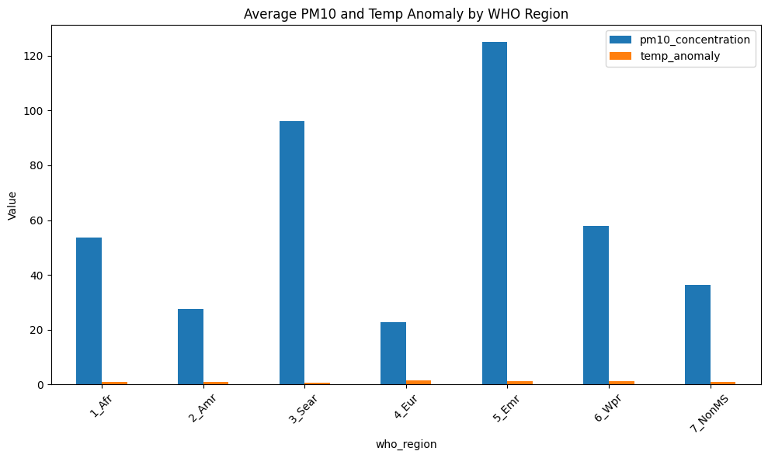
Temperature change correlation with air pollution levels
Data Visualization with Maps and Charts: the role of GIS

Slide 9
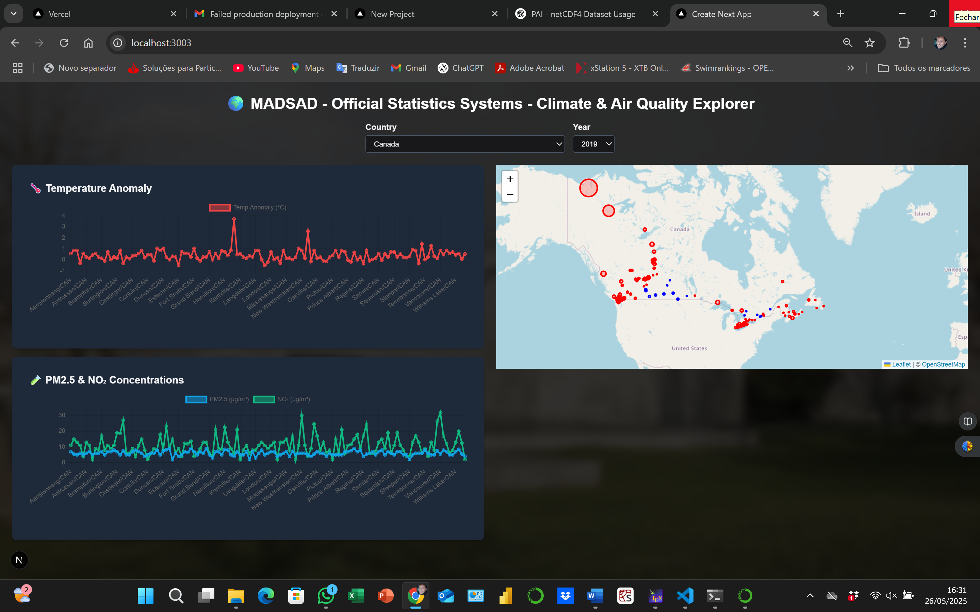
DASHBOARD
The web application allows the user to:
Select a country and a year using dropdown menus;
View line charts showing average temperature anomalies and pollutant concentrations per city
Explore an interactive map showing city locations and pollution levels, with circle size and color scaled by temperature anomaly.
Map automatically zooms to selected countries.
The project was used TailwindCSS
For now it runs at http://localhost:3000 but is in study a version deployed by Vercel through GitHub.
Temperature change correlation with air pollution levels
Data Visualization with Maps and Charts: the role of GIS

Slide 10
Thank you for your attention!

